Slide 1


MICROSOFT COPILOT FOR POWERPOINT

Slide 2
COPILOT IN POWERPOINT

Slide 3

Module Agenda
Microsoft CoPilot capabilities in PowerPoint
Create a Presentation from Scratch
Modify Text, Images, & Speaking Notes
Develop Presentations from PDFs and Word Documents
Create Presentations from Template
Summarize and Organize Existing PowerPoint Slides
Presentation Preparation & Delivery with CoPilot!
CoPilot PowerPoint Slides Coaching!
© All rights reserved for Dr. Ryan Ahmed @Stemplicity Inc.

Slide 4
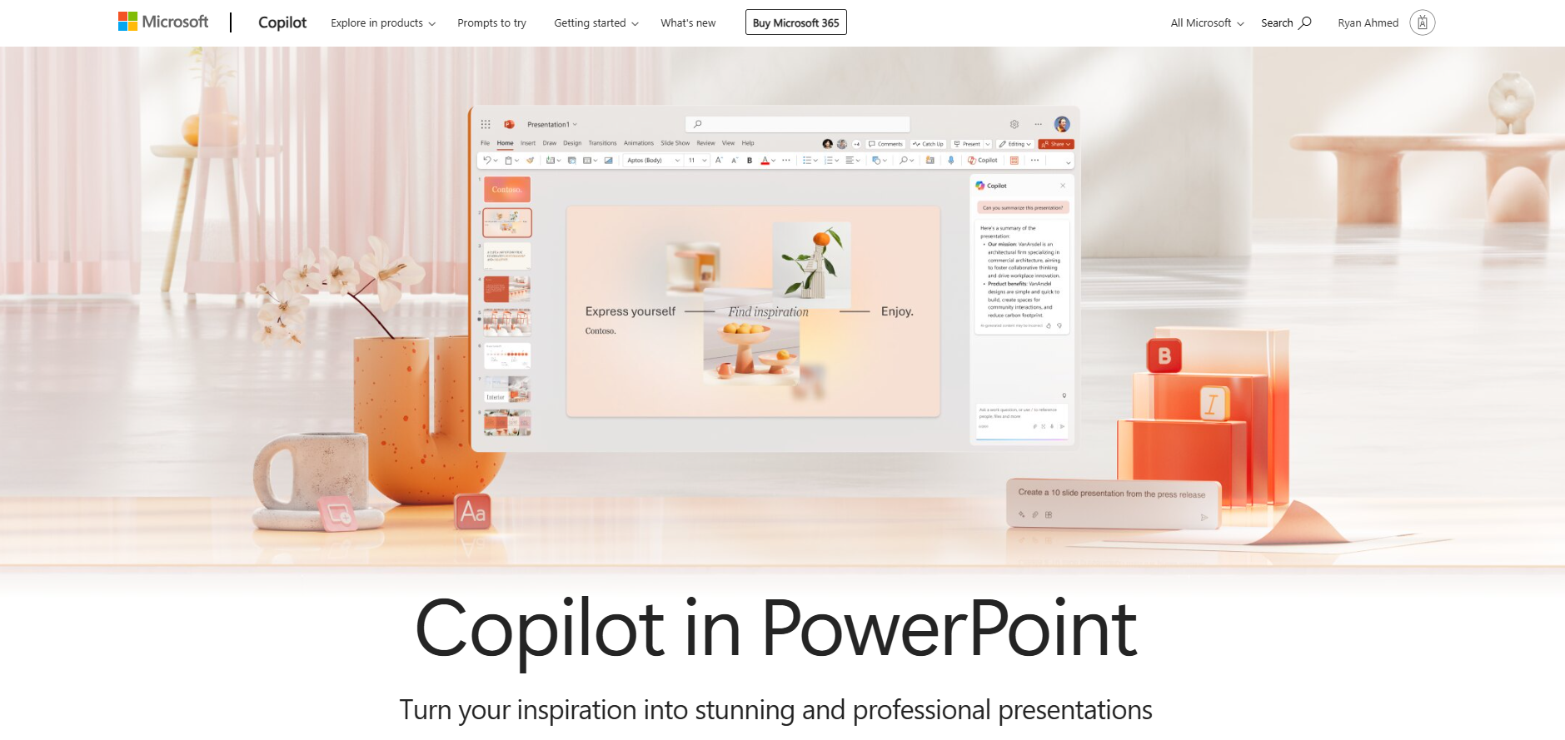
Microsoft CoPilot in PowerPoint
Microsoft's Copilot in PowerPoint is an AI-powered assistant that enhances your presentation creation process.
© All rights reserved for Dr. Ryan Ahmed @Stemplicity Inc.
Link: https://support.microsoft.com/en-us/copilot-powerpoint

Slide 5
Microsoft CoPilot in PowerPoint
Create a New Presentation: Provide Copilot with a topic, and it will draft a presentation for you, complete with content and design elements.
Summarize Your Presentation: For lengthy presentations, Copilot can generate a concise bulleted summary, highlighting the main points to help you quickly grasp the content.
Organize Your Presentation: Copilot can assist in restructuring your slides, ensuring a logical flow and coherent narrative throughout your presentation.
Use Your Organization's Branding: Copilot helps incorporate your organization's branding into the presentation by generating slides or images that align with your brand guidelines.
© All rights reserved for Dr. Ryan Ahmed @Stemplicity Inc.
Link: https://support.microsoft.com/en-us/copilot-powerpoint

Slide 6
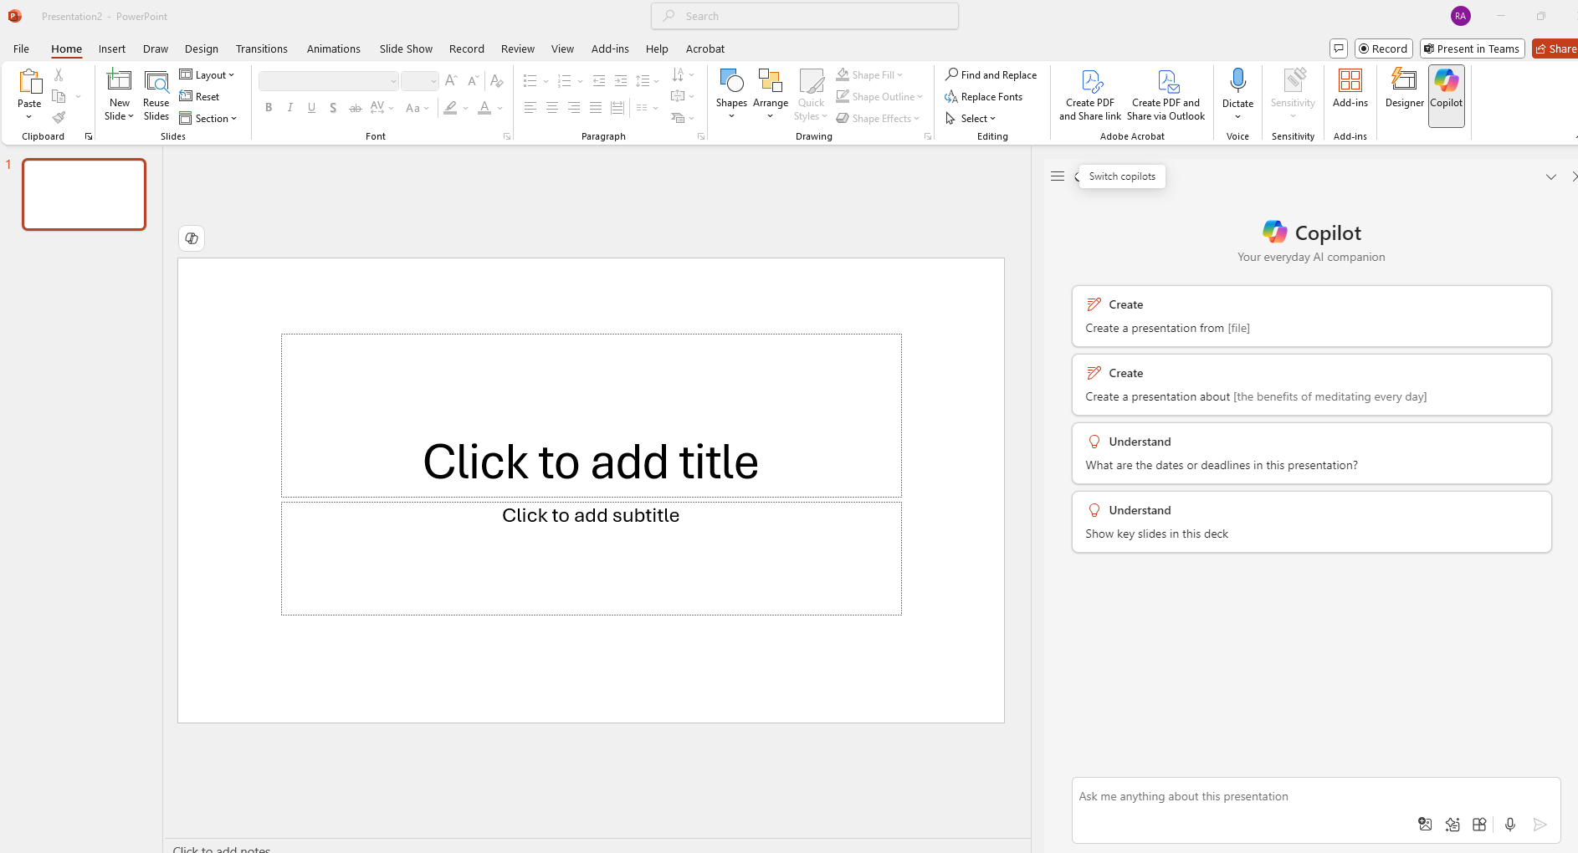
Microsoft CoPilot in PowerPoint
© All rights reserved for Dr. Ryan Ahmed @Stemplicity Inc.

Slide 7
LIVE DEMO

Slide 8
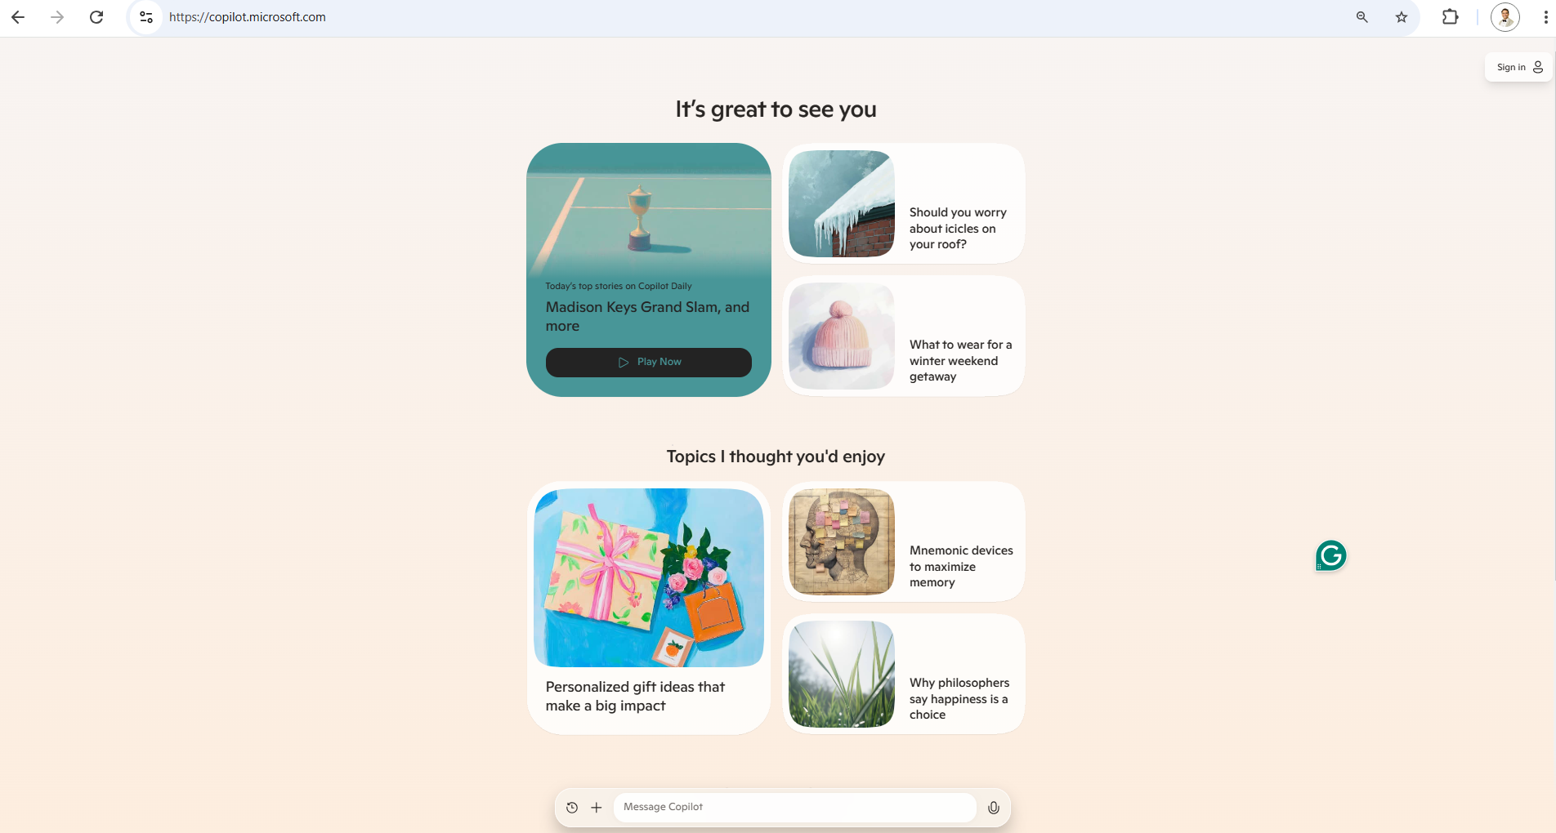
Live Demo
🔗 Click here to explore CoPilot CoPilot Signup
💡 Click here for AI Prompts Explore Prompts
© All rights reserved for Dr. Ryan Ahmed @Stemplicity Inc.

Slide 9
Thank you!

